Slide 1
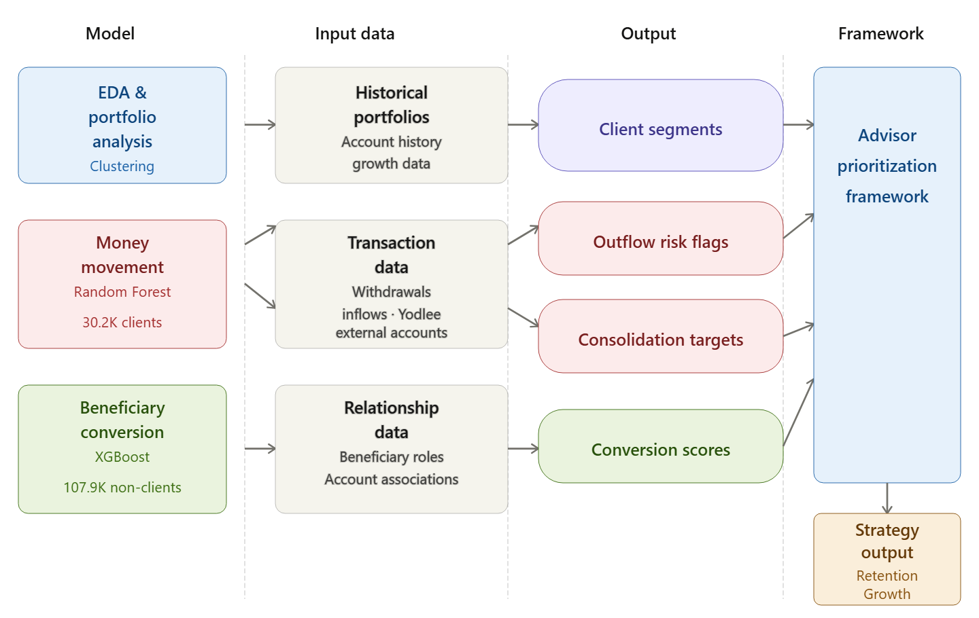
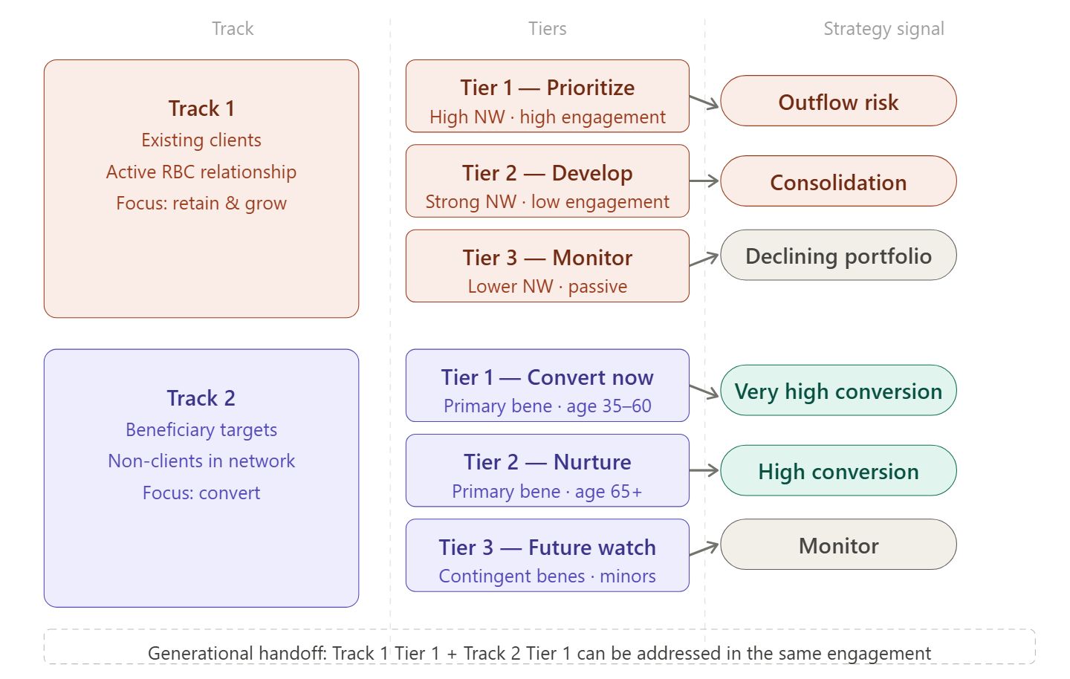
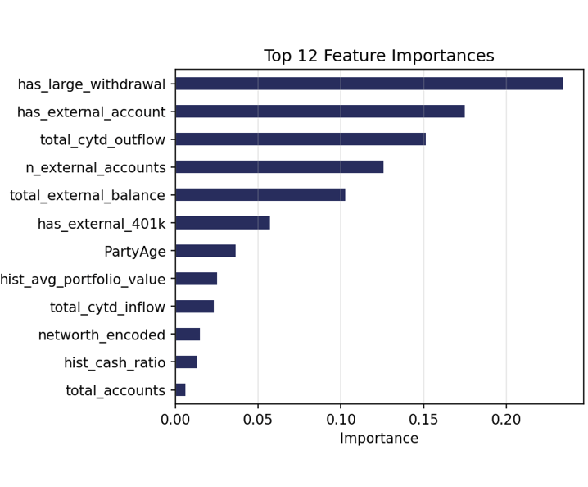
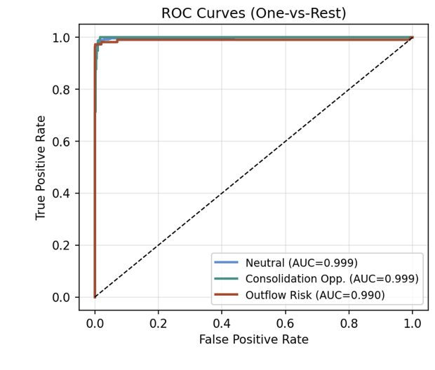
Behavioral Signal Detection and Advisor Prioritization in Wealth Management: A Multi-Model Approach for RBC
Segmenting Active Wealth Clients: Portfolio Behavior, Risk, and Consolidation Opportunity
Understanding client behavior is foundational for wealth management strategy. This analysis examines 29,930 active clients ($24.4B) to identify behavioral segments, risk concentrations, and business opportunities.
Key Findings:
Portfolio Behavior: 41.6% growing | 41.4% declining | 19.3% flat
Risk Profile: 98% standard-risk | 1.97% high-attention (requires enhanced monitoring)
Consolidation Opportunity: $1.1B external assets → $11M annual fee potential
Declining clients paradoxically present highest opportunity: 6.6% external-asset ratio suggests consolidation readiness. By segmenting clients systematically—by behavior, risk, and opportunity—this analysis enables data-driven advisor prioritization and wealth management strategy.
For Money Movement Model, we used Random Forest classifier trained on 30,200 active RBC clients. Labels engineered from behavioral signals: Outflow Risk, Consolidation Opportunity, and Neutral. SMOTE oversampling applied to address class imbalance. 11 features used, primarily from Yodlee external account data and Broadridge transaction history.
Beneficiary Conversion Model: XGBoost classifier trained on 107,870 non-client party associations. 57 features engineered exclusively from non-client relationships to RBC accounts — demographics, household membership, beneficiary roles, inheritance proximity signals, and campaign engagement history. Deliberately leakage-free design ensures all features are observable from the prospecting side only. scale_pos_weight used to handle class imbalance; 60/20/20 stratified train/val/test split with 5-fold cross-validation and early stopping (20 rounds) on validation AUC. Output: conversion probability (0–1) per non-client, assigned to priority tiers (Low / Medium / High / Very High) and clustered into 3 prospect segments via KMeans (k = 3).
Wealth management advisors operate with limited time and an incomplete picture of where that time is best spent. This project built three predictive models — portfolio segmentation, money movement prediction, and beneficiary conversion scoring — not as independent analyses but as a connected system. The combined output is an advisor prioritization framework that translates client and prospect data into actionable strategy signals (Figures 1 and 2).
The models surface three opportunity windows that would not be visible from the data alone. The 455 highest-confidence outflow-risk clients are long-tenured and older on average, suggesting wealth in motion due to life stage rather than dissatisfaction with RBC. The 643 consolidation targets are concentrated in their early 50s, a period where research consistently shows clients are most open to simplifying their financial lives. And the roughly 1,600 beneficiary conversion prospects are already embedded in existing client households, making them reachable through relationships RBC already holds. These findings should be read as signals rather than certainties. The models were trained on historical behavior and cannot confirm intent behind any individual data point. Critically, the framework has not yet been validated against live advisor outcomes, which remains the most important next step. Testing the strategy recommendations against real retention and conversion results over a defined period would move this work from a predictive model to a proven playbook.
Why This Matters
Wealth managers oversee billions in client assets but lack systematic client understanding. At RBC, 29,930 active clients, $24.4B wealth—which segments warrant retention focus? Which need risk monitoring? Which are consolidation targets?
Three Key Questions → Three Answers
Q1: How do clients perform? A: Balanced base—41.6% growing, 41.4% declining. Requires differentiated engagement.
Q2: Where is risk concentrated? A: Efficient concentration—98% standard-risk. Only 589 high-attention clients need enhanced monitoring.
Q3: What consolidation opportunity exists? A: $1.1B external assets. Declining clients show highest readiness (6.6% external ratio).
Key Insight
Declining clients ≠ just retention risk. They're the highest-opportunity consolidation target. Portfolio review + consolidation discussion = retention + growth.
Impact
Retention: Declining clients identified for proactive outreach
Risk Management: 589 VIP clients flagged for enhanced monitoring
Growth: $11M annual fee potential through systematic consolidation
The Money Movement Model achieved ROC-AUC of 0.999. Of 30,200 active clients scored: 556 flagged as Outflow Risk ($838M combined withdrawals) and 643 as Consolidation Opportunity ($789M in external AUM). Cross-validation confirmed 455 of 1,308 manually flagged at-risk accounts as genuine outflow risk ($817M at stake).
Beneficiary Conversion Model: The XGBoost classifier achieved a test ROC-AUC of 0.9574 and average precision of 0.9455 — consistent across train, cross-validation, and test splits, confirming no overfitting. Approximately 65% of all converters are captured in the top-scoring quintile. Of 107,870 non-client associations scored, 3,582 were identified as priority prospects: 1,585 Very High (conversion probability ≥ 70%) and 1,997 High (50–70%). Household membership (in_client_household) was by far the strongest predictor, followed by number of associated households and owner age. KMeans clustering (k = 3) revealed three actionable prospect segments: Segment 1 — Older Wealth-Adjacent (3,582 parties, avg prob 0.76), the dominant group associated with accounts held by primary owners aged 60+; Segment 2 — High-Value Associates (50 parties, avg prob 0.81), linked to the largest portfolio balances and highest revenue potential per prospect; Segment 3 — Minors / Long-term Pipeline (3 parties, avg prob 0.72), representing future acquisition opportunities as they approach financial independence.
This project demonstrates that the data wealth management firms already hold about their clients and client-adjacent relationships contains a level of strategic signal that routine reporting does not surface. By applying machine learning across three distinct but connected analytical workstreams, we were able to move from raw behavioral data to a structured, advisor-ready prioritization framework — one that distinguishes between clients who need retention attention, clients who are positioned to deepen their relationship with RBC, and non-clients who are already close enough to convert.
The framework is not a prediction about what clients might do in theory. It is grounded in observed behavioral patterns across 30,200 active clients and over 107,000 non-client parties, validated on held-out test data, and calibrated to the specific relationship structures that characterize wealth management at this scale. The models perform with high confidence — outflow and consolidation flags carry over 99% model certainty for the flagged population — which means the lists advisors receive are decisive rather than probabilistic.
The practical implication is significant. Across retention risk, consolidation opportunity, and beneficiary conversion, this framework identifies nearly $1.6 billion in combined at-risk and capturable assets, plus approximately 1,600 future clients already embedded in RBC's existing network. That is not a pipeline to be built. It is already there — and this framework tells advisors exactly where to look.
Aditi Beesani (abeesani@tepper.cmu.edu)
Celeste Zhou (celestez@tepper.cmu.edu)
Kevin Wang (kwang5@tepper.cmu.edu)
Natasha Niranjan (nniranj2@tepper.cmu.edu)

